Slide 1
AMIGOS Collaboration: Gilkes/Macklin
Macklin Lab
November 15, 2017

Slide 2
Starting Assumptions/Conditions
PDE advective like chemotactic flux
Hexagonal lattice, roughly in a circle of radius 270 um
Equal volume/shape voxels – 20 um radius - ~29 cells per voxel
~100 um diffusion length scale for O2 in tumor (2-3 voxels)
~1000 um diffusion length scale for O2 in normal tissue
~150 um diffusion length scale for angiogenic factor
Opposing tumor and vasculature
Simulation runs for 20 days
Color maps and histograms are actively updated to aid in debugging/trouble shooting. In production runs, they will be held constant.

Slide 3
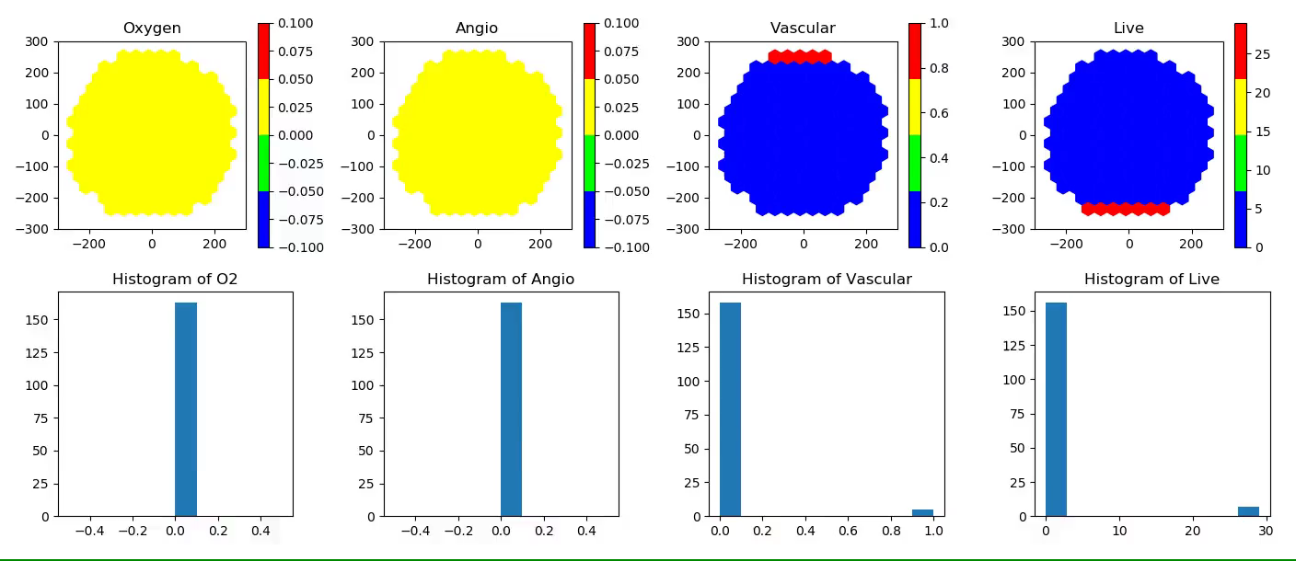
Test 1: Angiogenesis – Static Tumor

Slide 4

Test 2: Growing Tumor and Vasculature

Slide 5
Initial Application: 2-D “Spheroid”
Low density (1/2 of carrying capacity) seeded in approximate center of domain (tissue space)
Vasculature seeded on exterior of tissue space
Video begins at the beginning of day 20 of the simulation and runs until day 50
Growth rate is 6 times faster than previous videos
Color maps and histograms are actively updated to aid in debugging/trouble shooting. In production runs, they will be held constant.

Slide 6
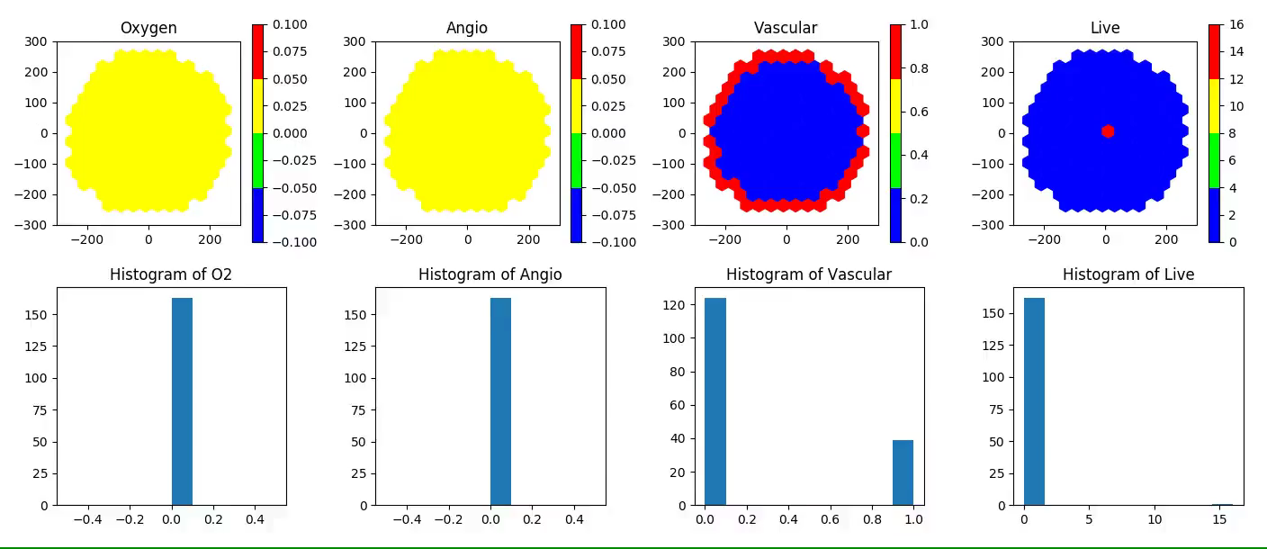
Spheroid

